Slide 1
Multimedia in Android
Video and Audio
A Beige Lesson by
Derek Stotz and Jonathan Tomes

Slide 2
MediaPlayer
Primary method of playing audio and video
Can play media from the phone, the application resources, or the net
Can be used in tandem with async tasks to prepare and play data without interfering with the UI thread
Can be used via a service to play as a background process

Slide 3
MediaPlayer
Core Common Supported Types (Assumes 4.1+):
Audio: MIDI, OGG, MP3, FLAC, 3GPP, MP4
Video: 3GPP, MP4, TS, WEBM, MKV
Manifest Declarations:
Internet, if using the internet for resources
Other permissions are app-specific

Slide 4
Accessing Resources
Video and Audio

Slide 5
Resource Folder
Stored in project’s res/raw/ directory
Summoned via:
MediaPlayer mediaPlayer = MediaPlayer.create(context, R.raw.sound_file);
mediaPlayer.start();

Slide 6
Resource in Phone
Stored in an accessible location on the phone.
URI must be obtained for the resource via a ContentResolver, or the URI class (which must be given an explicit file path)

Slide 7
Resource in Phone
How to easily get a URI and launch in mediaPlayer:
Uri myUri = Uri.fromFile(new File("/sdcard/audio_file.ogg"));
MediaPlayer mediaPlayer = new MediaPlayer();
mediaPlayer.setAudioStreamType(AudioManager.STREAM_MUSIC);
mediaPlayer.setDataSource(getApplicationContext(), myUri);
mediaPlayer.prepare();
mediaPlayer.start();
AudioManager provides access to volume control

Slide 8
Remote Resources
Media file is stored at a web address
File must be accessed and prepared for playback:
String url = "http://www.website.com/sound_file.ogg”
MediaPlayer mediaPlayer = new MediaPlayer();
mediaPlayer.setAudioStreamType(AudioManager.STREAM_MUSIC);
mediaPlayer.setDataSource(url);
mediaPlayer.prepare();
mediaPlayer.start();

Slide 9
MediaPlayer Lifecycle
A Tale of Kings and Snakes

Slide 10
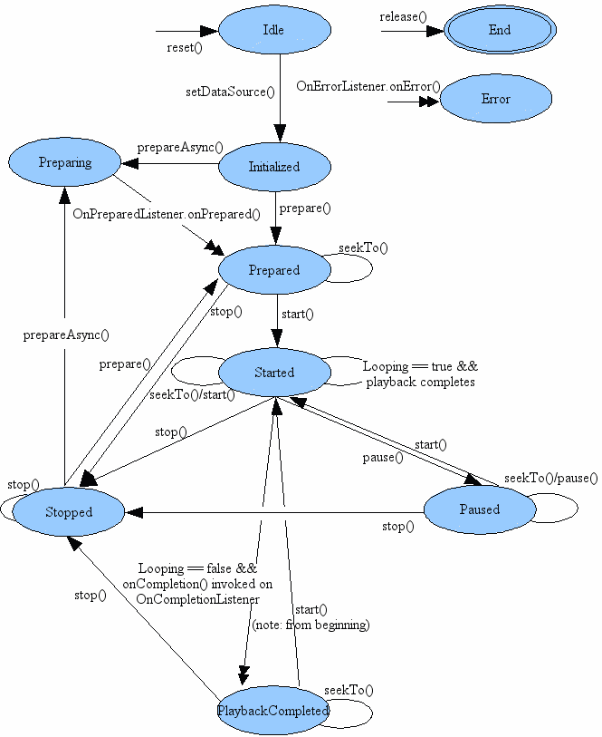
Source:
http://developer.android.com/reference/android/media/MediaPlayer.html

Slide 11
Idle and Initialized
Idle state:
The media player enters the idle state with new or reset()
If you used one of the create methods, the media player is NOT in the idle state, but instead, if successful, the media player is in the prepared state.
Initialized state:
Calling one of the setDataSource() methods will transition the media player from the Idle state to the
Initialized state.
An illegalStateException is thrown if setDataSource() is called from any other state.

Slide 12
Preparing and Prepared State:
The media player must be in the Prepared state before media playback can begin.
There are two ways to enter the prepared state:
1) using prepare() which transits to the prepared state once it returns.
2) Using prepareAsync(), which transits the media player into the transient Preparing state, which it completes almost immediately.
An illegalStateException is thrown if prepare() or prepareAsync() is called in any other state than Initialized.
While in the Prepared state properties such as sound volume, looping and screenOnWhilePlaying can be adjusted.

Slide 13
Started:
The player will go to this state once start() is called. In this state media play back is taking place.
isPlaying() can be used to test if the media player is in the Started state.
While in the started state, the player can call a user supplied OnBufferingUpdate.onBufferingUpdate() callback method if an OnBufferingUpdate listener has been registered before hand via setOnBufferingUpdateListener().
This callback allows applications to keep track of buffering status while streaming audio/video.

Slide 14
Paused:
Entered by calling pause().
Entering the pause state from started and vice versa can take some time to register in calls to isPlaying()especially when streaming content.
Calling start() from a paused media player will cause playback to continue from where it was paused.
Calling pause() from a player in the paused state will have no effect.

Slide 15
Stopped:
Entered by calling stop().
Once in the stopped state play back can not be started again till prepare() or prepareAsync() are called to set it back to the prepared state.
Calling stop() on a media player already in the stopped state has no effect.

Slide 16
PlaybackCompleted:
Entered when the media source has reached the end of the stream.
If looping is set to true, remains in the started state and starts playing from the beginning. If looping is set to false a call to the callback method onCompletion()
When in this state a call to start() begins playback from the beginning of the stream.

Slide 17
Source:
http://developer.android.com/reference/android/media/MediaPlayer.html

Slide 18
Using the MediaPlayer
Specific Cases

Slide 19
Play video in a surface view:
in activity onCreate():
sv = (SurfaceView) findViewById(R.id.surfaceView1);
sv.setVisibility(View.GONE);
sh = sv.getHolder();
sh.setFixedSize(176, 144);
sh.addCallback(this);
sh.setType(SurfaceHolder.SURFACE_TYPE_PUSH_BUFFERS); //Deprecated, but works
when the video is played:
getWindow().setFormat(PixelFormat.UNKNOWN);
sv.setVisibility(View.VISIBLE);
medPlayer = MediaPlayer.create(this, R.raw.video_file);
medPlayer.setAudioStreamType(AudioManager.STREAM_MUSIC);
medPlayer.start();

Slide 20
Preparing Remote Media Asynchronously
when the video is played (Main Activity implements MediaPlayer.OnPreparedListener):
String url = "http://........"; // your URL here MediaPlayer mediaPlayer = new MediaPlayer(); mediaPlayer.setAudioStreamType(AudioManager.STREAM_MUSIC);
mediaPlayer.setOnPreparedListener(this); mediaPlayer.setDataSource(url); mediaPlayer.asyncPrepare(); // starts an async task
in the Main Activity’s implemented onPrepared function:
mediaPlayer.start();

Slide 21
Playing Music in a Service!
public class MyService extends Service implements MediaPlayer.OnPreparedListener { private static final ACTION_PLAY = "com.example.action.PLAY"; MediaPlayer mMediaPlayer = null; public int onStartCommand(Intent intent, int flags, int startId) { ... if (intent.getAction().equals(ACTION_PLAY)) { mMediaPlayer = ... // initialize it here mMediaPlayer.setOnPreparedListener(this); mMediaPlayer.prepareAsync(); // prepare async to not block main thread } } /** Called when MediaPlayer is ready */ public void onPrepared(MediaPlayer player) { player.start(); } }

Slide 22
End
But first, the app.

Slide 23
References
http://developer.android.com/reference/android/media/MediaPlayer.html
http://developer.android.com/guide/topics/media/mediaplayer.html
http://developer.android.com/guide/appendix/media-formats.html
http://developer.android.com/reference/android/media/AudioManager.html
http://developer.android.com/reference/android/net/Uri.html
http://androidcodeexamples.blogspot.com/2011/08/how-to-play-video-in-media-player.html
video/audio source:
http://www.youtube.com/watch?v=ygI-2F8ApUM

